Slide 1
Institute's Clubs and Senate Management System
Group no-9
Under the guidance of
Dr. Pritee Khanna
Associate Professor
Computer Science & Engineering
Presented By
Palash Rathore 2018173
Pranav Choudhary 2018184
Vedant Golhani 2018275
PDPM Indian Institute of Information Technology Design And Manufacturing, Jabalpur

Slide 2
OBJECTIVES
Online Voting
One place for all clubs
Reduces human error
Clubs and Senate Management System
Efficient and secure method
Online management of clubs
Saves time

Slide 3
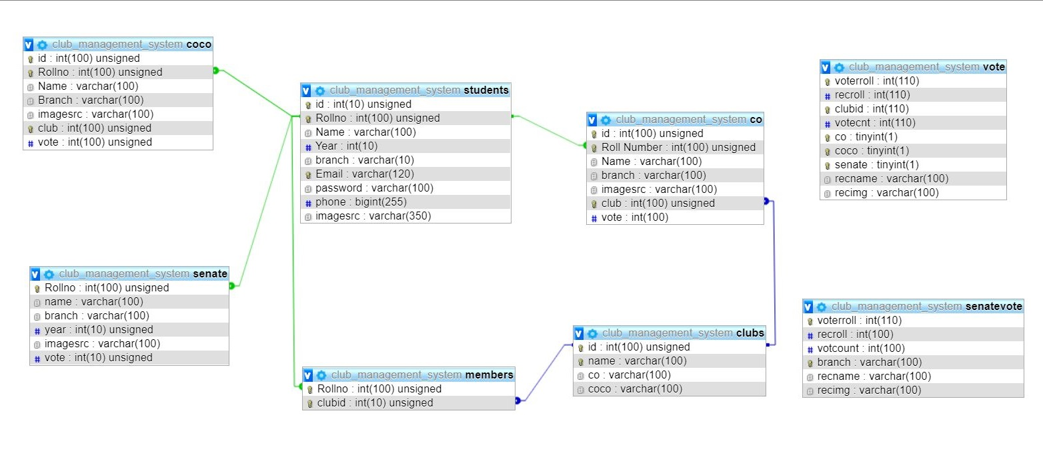
Design View

Slide 4
Tools and Software used
Php
Wamp
HTML and CSS
CSS framework Bootstrap

Slide 5
Steps to run website in your computer
Copy files in C:\wamp64\www folder
Run WAMP server
Copy database.txt and paste in SQl terminal
Now database is created
Open http://localhost/CMS/base.php in browser

Slide 6
THANK YOU

